Slide 1
Session 05 : Android Application’s Life Cycle
Module 4.3 : Android

Slide 2
Learning Objectives
At the end of the session successful participants will be able to
Understand android application life cycle.

Slide 3
Application’s Life Cycle
Android Applications
An application consists of one or more components that are defined in the application's manifest file. A component can be one of the following:
An Activity
A Service
A Broadcast Receiver
A Content Provider

Slide 4
Application’s Life Cycle
Android Applications
An Activity
An activity usually presents a single visual user interface from which a number of actions could be performed.
Although activities work together to form a cohesive user interface, each activity is independent of the others.

Slide 5
Application’s Life Cycle
Android Applications
An Activity
Typically, one of the activities is marked as the first one that should be presented to the user when the application is launched.
Moving from one activity to another is accomplished by having the current activity start the next one through so called intents.

Slide 6
Application’s Life Cycle
Android Applications
A Service
A service doesn't have a visual user interface, but rather runs in the background for an indefinite period of time.
It's possible to connect to (bind to) an ongoing service (and start the service if it's not already running).
While connected, you can communicate with the service through an interface that the service exposes.

Slide 7
Application’s Life Cycle
Android Applications
A Broadcast Receiver
A broadcast receiver is a component that does nothing but receive and react to broadcast announcements.
Many broadcasts originate in system code (Example: “you got mail“) but any other applications can also initiate broadcasts.
Broadcast receivers do not display a user interface. However, they may start an activity in response to the information they receive, or -as services do - they may use the notification manager to alert the user.

Slide 8
Application’s Life Cycle
Android Applications
A Content Provider
A content provider makes a specific set of the application's data available to other applications.
The data usually is stored in the file system, or in an SQLite database.

Slide 9
Application’s Life Cycle
Android Applications
A Content Provider
The content provider implements a standard set of methods that enable other applications to retrieve and store data of the type it controls.
However, applications do not call these methods directly. Rather they use a content resolver object and call its methods instead. A content resolver can talk to any content provider; it cooperates with the provider to manage any inter process communication that's involved.

Slide 10
Application’s Life Cycle
Android Applications
Every Android application runs in its own process(with its own instance of the Dalvik virtual machine).
Whenever there's a request that should be handled by a particular component,
Android makes sure that the application process of the component is running
Starting it if necessary, and
Android make sure an appropriate instance of the component is available, creating the instance if necessary

Slide 11
Application’s Life Cycle
Android Application’s Life Cycle
A Linux process encapsulating an Android application is created for the application when some of its code needs to be run, and will remain running until:
It is no longer needed, OR
The system needs to reclaim its memory for use by other applications

Slide 12
Application’s Life Cycle
Android Application’s Life Cycle
An unusual and fundamental feature of Android is that an application process's lifetime is not directly controlled by the application itself.
Instead, it is determined by the system through a combination of:
The parts of the application that the system knows are running
How important these things are to the user, and
How much overall memory is available in the system

Slide 13
Application’s Life Cycle
Components Life Cycle
Application components have a lifecycle:
Beginning
Between
End
A beginning when Android instantiates them to respond to intents
In between, they may sometimes be active or inactive, or -in the case of activities-visible to the user or invisible.
An end when the instances are destroyed.

Slide 14
Application’s Life Cycle
Activity Stack
Activities in the system are managed as an activity stack.
When a new activity is started, it is placed on the top of the stack and becomes the running activity --the previous activity always remains below it in the stack, and will not come to the foreground again until the new activity exits.
If the user presses the Back Button the next activity on the stack moves up and becomes active.

Slide 15
Application’s Life Cycle
Activity Stack
New Activity
Running Activity
New Activity Started
Back button pushed or
Running activity closed
Last Running Activity
Activity n-1
. . .
Activity Stack
Previous Activities
Activity 3
Activity 2
Back button pushed or
Running activity closed
Activity 1

Slide 16
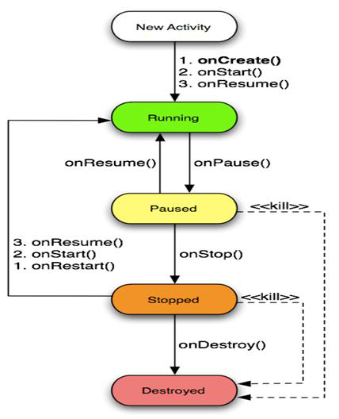
Application’s Life Cycle
Life Cycle States
An activity has essentially three states:
It is active or running
It is paused or
It is stopped

Slide 17

Application’s Life Cycle
Life Cycle States
An activity has essentially three states:
It is active or running when it is in the fore ground of the screen(at the top of the activity stack for the current task).
This is the activity that is the focus for the user's actions.

Slide 18

Application’s Life Cycle
Life Cycle States
An activity has essentially three states:
It is paused if it has lost focus but is still visible to the user.
That is, another activity lies on top of it and that new activity either is transparent or doesn't cover the full screen.
A paused activity is completely alive(it maintains all state and member information and remains attached to the window manager), but can be killed by the system in extreme low memory situations.

Slide 19

Application’s Life Cycle
Life Cycle States
An activity has essentially three states:
It is stopped if it is completely obscured by another activity.
It still retains all state and member information. However, it is no longer visible to the user so its window is hidden and it will often be killed by the system when memory is needed elsewhere.

Slide 20
Application’s Life Cycle
Life Cycle
Activity Starts
onCreate()
User navigates back to the activity
onStart()
onRestart()
onResume()
Process is Killed
Activity is Running
The activity comes
to the foreground
Another activity comes in front
of the other activity
Other applications
need memory
onPause()
The activity comes
to the foreground
The activity is no longer visible
onStop()
onDestroy()
Activity is Shutdown

Slide 21
Application’s Life Cycle
Life Cycle Events
If an activity is paused or stopped, the system can drop it from memory either by asking it to finish (calling its finish() method), or simply killing its process.
When it is displayed again to the user, it must be completely restarted and restored to its previous state.
As an activity transitions from state to state, it is notified of the change by calls to the following protected transition methods:
void onCreate(Bundle savedInstanceState) void onStart() void onRestart() void onResume() | void onPause() void onStop() void onDestroy()

Slide 22
Application’s Life Cycle
Life Cycle Events
void onCreate(Bundle savedInstanceState) void onStart() void onRestart() void onResume() | void onPause() void onStop() void onDestroy()
All of these methods are hooks that you can override to do appropriate work when the state changes.
All activities must implement onCreate() to do the initial setup when the object is first instantiated.
Many activities will also implement onPause() to commit data changes and otherwise prepare to stop interacting with the user.

Slide 23
Application’s Life Cycle
Applications Lifetime
void onCreate(Bundle savedInstanceState) void onStart() void onRestart() void onResume() | void onPause() void onStop() void onDestroy()
The seven transition methods define the entire lifecycle of an activity.
The entire lifetime of an activity happens between the first call to onCreate() through to a single final call to onDestroy().
An activity does all its initial setup of "global" state in onCreate(), and releases all remaining resources in onDestroy().

Slide 24
Application’s Life Cycle
Visible Lifetime
The visible lifetime of an activity happens between a call to onStart() until a corresponding call to onStop().
During this time, the user can see the activity on-screen, though it may not be in the foreground and interacting with the user.
The onStart() and onStop() methods can be called multiple times, as the activity alternates between being visible and hidden to the user.
Between these two methods, you can maintain resources that are needed to show the activity to the user.

Slide 25
Application’s Life Cycle
Foreground Lifetime
The foreground lifetime of an activity happens between a call to onResume() until a corresponding call to onPause().
During this time, the activity is in front of all other activities on screen and is interacting with the user.
An activity can frequently transition between the resumed and paused states — for example,
onPause() is called when the device goes to sleep or when a new activity is started,
onResume() is called when an activity result or a new intent is delivered.

Slide 26
Application’s Life Cycle
Life Cycle Methods
onCreate()
Called when the activity is first created.
This is where you should do all of your normal static set up —create views, bind data to lists, and so on.
This method is passed a Bundle object containing the activity's previous state, if that state was captured.
Always followed by onStart()

Slide 27
Application’s Life Cycle
Life Cycle Methods
onRestart()
Called after the activity has been stopped, just prior to it being started again.
Always followed by onStart()

Slide 28
Application’s Life Cycle
Life Cycle Methods
onStart()
Called just before the activity becomes visible to the user.
Followed by onResume() if the activity comes to the foreground, or onStop() if it becomes hidden.

Slide 29
Application’s Life Cycle
Life Cycle Methods
onResume()
Called just before the activity starts interacting with the user.
At this point the activity is at the top of the activity stack, with user input going to it.
Always followed by onPause().

Slide 30
Application’s Life Cycle
Life Cycle Methods
onPause()
Called when the system is about to start resuming another activity.
This method is typically used to commit unsaved changes to persistent data, stop animations and other things that may be consuming CPU, and so on.
It should do whatever it does very quickly, because the next activity will not be resumed until it returns.

Slide 31
Application’s Life Cycle
Life Cycle Methods
onPause()
Followed either by onResume() if the activity returns back to the front, or by onStop() if it becomes invisible to the user.
The activity in this state is killable by the system.

Slide 32
Application’s Life Cycle
Life Cycle Methods
onStop()
Called when the activity is no longer visible to the user.
This may happen because it is being destroyed, or because another activity (either an existing one or a new one) has been resumed and is covering it.

Slide 33
Application’s Life Cycle
Life Cycle Methods
onStop()
Followed either by onRestart() if the activity is coming back to interact with the user, or by onDestroy() if this activity is going away.
The activity in this state is killable by the system.

Slide 34
Application’s Life Cycle
Life Cycle Methods
onDestroy()
Called before the activity is destroyed.
This is the final call that the activity will receive.
It could be called either because the activity is finishing (someone called finish()on it), or because the system is temporarily destroying this instance of the activity to save space.

Slide 35
Application’s Life Cycle
Life Cycle Methods
onDestroy()
You can distinguish between these two scenarios with the is Finishing() method.
The activity in this state is killable by the system.

Slide 36
Application’s Life Cycle
Life Cycle Methods
Activities on killable states can be terminated by the system at any time after the method returns, without executing another line of the activity's code.
Three methods (onPause(), onStop(), and onDestroy()) are killable.
onPause() is the only one that is guaranteed to be called before the process is killed —onStop() and onDestroy() may not be.
Therefore, you should use onPause() to write any persistent data (such as user edits) to storage.

Slide 37
Application’s Life Cycle
Life Cycle Methods
Killable States
Activities on killable states can be terminated by the system at any time after the method returns, without executing another line of the activity's code.
Three methods (onPause(), onStop(), and onDestroy()) are killable.
onPause() is the only one that is guaranteed to be called before the process is killed —onStop() and onDestroy() may not be.
Therefore, you should use onPause() to write any persistent data (such as user edits) to storage.

Slide 38
Application’s Life Cycle
Life Cycle Methods
Android Preferences
Preferences is a lightweight mechanism to store and retrieve key-value pairs of primitive data types.
It is typically used to store application preferences, such as a default greeting or a text font to be loaded whenever the application is started.

Slide 39
Application’s Life Cycle
Life Cycle Methods
Android Preferences
Call Context.getSharedPreferences() to read and write values
Assign a name to your set of preferences if you want to share them with other components in the same application, or use Activity.getPreferences() with no name to keep them private to the calling activity.
You cannot share preferences across applications (except by using a content provider).

Slide 40
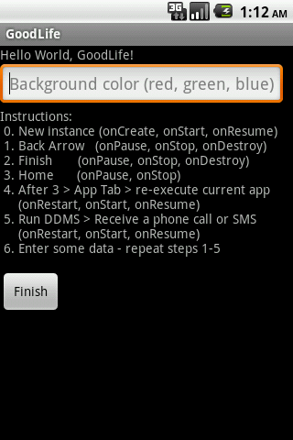
Application’s Life Cycle
Life Cycle Methods
Example: Application
The following application demonstrates some of the state transitioning situations experienced in the life-cycle of a typical Android activity.

Slide 41
Application’s Life Cycle
Life Cycle Methods
Example: Application Code
<?xml version="1.0" encoding="utf-8"?>
<LinearLayoutxmlns:android="http://schemas.android.com/apk/res/android"
android:id="@+id/myScreen"
android:orientation="vertical"
android:layout_width="fill_parent"
android:layout_height="fill_parent"
android:background="#ff000000"
>
<TextView
android:layout_width="fill_parent"
android:layout_height="wrap_content“

Slide 42
Application’s Life Cycle
Life Cycle Methods
Example: Application Code
android:text="@string/hello"
/>
<EditText
android:id="@+id/txtColorSelect"
android:hint="Background color (red, green, blue)"
android:layout_width="wrap_content"
android:layout_height="wrap_content">
</EditText>
<TextView
android:id="@+id/txtToDo"
android:layout_width="fill_parent"
android:layout_height="wrap_content“

Slide 43
Application’s Life Cycle
Life Cycle Methods
Example: Application Code
android:background="#00000000">
<!--transparent -->
</TextView>
<Button
android:text=" Finish "
android:id="@+id/btnFinish"
android:layout_width="wrap_content"
android:layout_height="wrap_content">
</Button>
</LinearLayout>

Slide 44
Application’s Life Cycle
Life Cycle Demo – Part 01
Package cis493.lifecycle
Import android.app.Activity;
Import android.content.SharedPreferences;
Import android.os.Bundle;
Import android.view.View;
Import android.widget.*;
//GOAL: show the following life-cycle events in action
//protected void onCreate(Bundle savedInstanceState);
//protected void onStart();
//protected void onRestart();
//protected void onResume();
//protected void onPause();
//protected void onStop();
//protected void onDestroy();

Slide 45
Application’s Life Cycle
Life Cycle Demo – Part 02
@Override
Public void on Create(Bundle savedInstanceState) {
super.onCreate(savedInstanceState);
setContentView(R.layout.main);
myScreen= (LinearLayout) findViewById(R.id.myScreen);
txtToDo= (TextView) findViewById(R.id.txtToDo);
String msg= "Instructions: \n "
+ "0. New instance (onCreate, onStart, onResume) \n "
+ "1. Back Arrow (onPause, onStop, onDestroy) \n "
+ "2. Finish (onPause, onStop, onDestroy) \n "
+ "3. Home (onPause, onStop) \n "
+ "4. After 3 > App Tab > re-execute current app \n "
+ " (onRestart, onStart, onResume) \n "
+ "5. Run DDMS > Receive a phone call or SMS \n “

Slide 46
Application’s Life Cycle
Life Cycle Demo – Part 02
+ " (onRestart, onStart, onResume) \n "
+ "6.Enter data-repeat steps 1-5\n";
txtToDo.setText(msg);
txtColorSelect= (EditText) findViewById(R.id.txtColorSelect);// you may want to skip discussing the listener until latertxtColorSelect.addTextChangedListener(newTextWatcher(){ publicvoidonTextChanged(CharSequences, intstart, intbefore, intcount) {// TODOAuto-generated method stub}publicvoidbeforeTextChanged(CharSequences, intstart, intcount,intafter) {// TODOAuto-generated method stub}publicvoidafterTextChanged(Editable s) {changeBackgroundColor(s.toString());}});btnFinish= (Button) findViewById(R.id.btnFinish);

Slide 47
Application’s Life Cycle
Life Cycle Demo – Part 02
findViewById(R.id.btnFinish);btnFinish.setOnClickListener(newOnClickListener() {publicvoidonClick(View arg0) {finish();} }); Toast.makeText(getApplicationContext(), "onCreate", 1).show();

Slide 48
Application’s Life Cycle
Life Cycle Demo – Part 03
@Override
protectedvoidonPause() {
super.onPause();
saveDataFromCurrentState();
Toast.makeText(this, "onPause", 1).show();}
@Override
protectedvoidonRestart() {
super.onRestart();
Toast.makeText(this, "onRestart", 1).show();}
@Override
protectedvoidonResume() {
super.onResume();
Toast.makeText(this, "onResume", 1).show();
}

Slide 49
Application’s Life Cycle
Life Cycle Demo – Part 04
@Override
protectedvoidonStart() {// TODOAuto-generated method stub
super.onStart();
updateFromSavedState();
Toast.makeText(this, "onStart", 1).show();}
@Override
protectedvoidonDestroy(){// TODOAuto-generated method stub
super.onDestroy();
Toast.makeText(this, "onDestroy", 1).show();}
@Override
protectedvoidonStop() {// TODOAuto-generated method stub
super.onStop();
Toast.makeText(this, "onStop", 1).show();
}

Slide 50
Application’s Life Cycle
Life Cycle Demo – Part 05
protectedvoidsaveDataFromCurrentState() {
SharedPreferencesmyPrefs= getSharedPreferences(MYPREFSID, actMode);
SharedPreferences.EditormyEditor= myPrefs.edit();
myEditor.putString("myBkColor", txtColorSelect.getText().toString());
myEditor.commit();
}// saveDataFromCurrentState
protectedvoidupdateFromSavedState() {
SharedPreferencesmyPrefs= getSharedPreferences(MYPREFSID, actMode);
if((myPrefs!= null) && (myPrefs.contains("myBkColor"))) {
String theChosenColor= myPrefs.getString("myBkColor", "");
txtColorSelect.setText(theChosenColor);changeBackgroundColor(theChosenColor);

Slide 51
Application’s Life Cycle
Life Cycle Demo – Part 05
}
}// UpdateFromSavedState
protectedvoidclearMyPreferences() {
SharedPreferencesmyPrefs= getSharedPreferences(MYPREFSID, actMode);
SharedPreferences.EditormyEditor= myPrefs.edit();
myEditor.clear();
myEditor.commit();
}

Slide 52
Application’s Life Cycle
Life Cycle Demo – Part 06
privatevoidchangeBackgroundColor(String theChosenColor){// change background colorif(theChosenColor.contains("red"))myScreen.setBackgroundColor(0xffff0000);elseif(theChosenColor.contains("green"))myScreen.setBackgroundColor(0xff00ff00);elseif(theChosenColor.contains("blue"))myScreen.setBackgroundColor(0xff0000ff);else{//resetinguser preferencesclearMyPreferences();myScreen.setBackgroundColor(0xff000000);}}

Slide 53
Application’s Life Cycle
Life Cycle Demo – Part 07
/* protected void onRestoreInstanceState(Bundle savedInstanceState) This method is called after onStart() when the activity is being re-initialized from a previously saved state. The default implementation of this method performs a restore of any view state that had previously been frozen by onSaveInstanceState(Bundle). */@OverrideprotectedvoidonRestoreInstanceState(BundlesavedInstanceState) {super.onRestoreInstanceState(savedInstanceState);Toast.makeText(getBaseContext(), "onRestoreInstanceState...BUNDLING",Toast.LENGTH_LONG).show();}

Slide 54
Application’s Life Cycle
Life Cycle Demo – Part 08
/*
protected void onSaveInstanceState(Bundle outState) Called to retrieve per-instance state from an activity before being killed so that the state can be restored in onCreate(Bundle) or onRestoreInstanceState(Bundle) (the Bundle populated by this method will be passed to both).
This method is called before an activity may be killed so that when it comes back some time in the future it can restore its state. For example, if activity B is launched in front of activity A, and at some point activity A is killed to reclaim resources, activity A will have a chance to save the current state of its user interface via this method so that when the user returns to activity A, the state of the user interface can be restored via: onCreate(Bundle) or onRestoreInstanceState(Bundle). */

Slide 55
Application’s Life Cycle
Life Cycle Demo – Part 09
@Override
protectedvoidonSaveInstanceState(Bundle outState) {
super.onSaveInstanceState(outState);
Toast.makeText(getBaseContext(),
"onSaveInstanceState...BUNDLING",
Toast.LENGTH_LONG).show();
} // onSaveInstanceState
}//LyfeCicleDemo

Slide 56
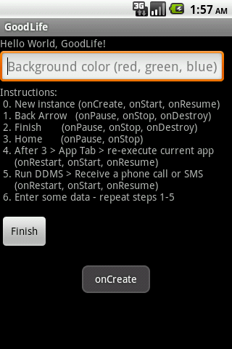
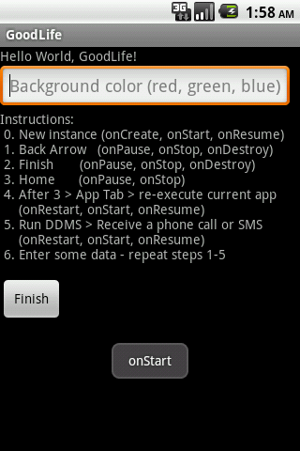

Application’s Life Cycle
Life Cycle Demo
onCreate()
onStart()
onResume()

Slide 57
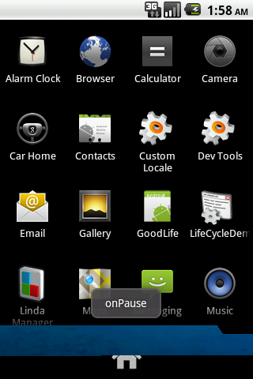
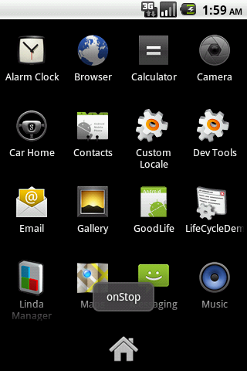
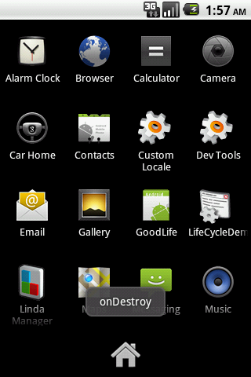
Application’s Life Cycle
Life Cycle Demo
onPause()
onStop()
onDestroy()
After pressing “Back Arrow”

Slide 58
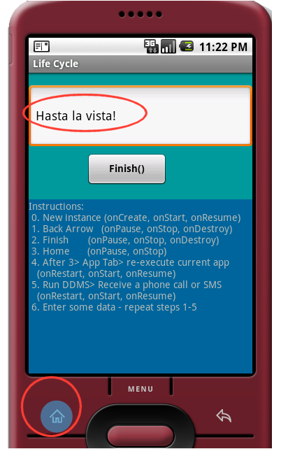
Application’s Life Cycle
Life Cycle Demo
After pressing “Home” | After re-executing AndLife2 | After “Back Arrow” or Finish
onSavedInstanceState> onPause> onStop> | onRestart> onStart> onResume> | onPause> onStop> onDestroy>
Preserving State Information
Enterdata: “Hastala vista!” Click Home button onSavedInstance> onPause> onStop Read yourSMS Execute an instance of the application onRestart> onStart> onResume You see the data entered in step 1

